Slide 1
LightGBM Algorithms
Detailed presentation

Slide 2
What is LightGBM (Lightweight Gradient Boosting Machine) Algorithms
Week Model 1
Predictions on Model 1 (y1)
Data 1
GOSS
Y=Base_tree(X)-lr*Tree1(X)-lr*Tree2(X)-lr*Tree3(X)
Data 2
Week Model 2
Predictions on Model 2 (y2)
Final Model
Predictive Model 2 result
Predictive Model 3 result
GOSS
Data (n)
Week Model n
Prediction on Model n (yn)
Week Model 1,2,..n are individual models. GOSS - Gradient based One Side Sampling

Slide 3
Why LGBM?
Faster training
Lower memory usage
It has support of parallel, distributed and GPU learning
Better accuracy
Capable to handle large scale data

Slide 4
How it 10X faster than XG Boost?
GOSS (Gradient Based One Side Sampling) - better sampling
Whenever the error or gradient increases , the algorithm sort the gradients in descending order (high error …low error) and then it create next datasets with top 20 gradient record first (20%) and sample (10%) of small gradient records from the 80% of records and the sampling is happening only on the right hand side (ie 80% of the data) so it is called one side Sampling
EFB (Exclusive Feature Bundling) - better Feature Engineering
Ex: if you have gender where M is 1 and F is 0 , we can create bundle like M is 11 and F is 10. In this way we can make the algorithm by reducing the 2D to 1D

Slide 5
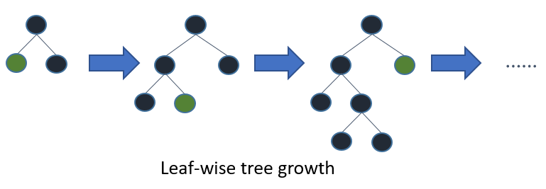
How it split the data?
LightGBM is a gradient boosting framework that uses tree based learning algorithms. It split the tree leaf wise i.e it will split the leaf node with the biggest split gain out of all the tree’s leaves. The tree might be unbalanced.

Slide 6
Tuning Parameters of Light GBM
Better split:
num_leaves : This parameter is used to set the number of leaves to be formed in a tree. Make sure num_leaves set must be smaller than 2^(max_depth) otherwise it may lead to overfitting.
min_data_in_leaf : It is also one of the important parameters in dealing with overfitting. Setting its value smaller may cause overfitting so Its value should be hundreds to thousands of large datasets.
max_depth: It specifies the maximum depth or level up to which tree can grow
Try lambda_l1, lambda_l2 and min_gain_to_split for regularization
Faster speed
bagging_fraction : Is used to perform bagging for faster results
feature_fraction : Set fraction of the features to be used at each iteration
max_bin : Smaller value of max_bin can save much time as it buckets the feature values in discrete bins which is computationally inexpensive.
Better accuracy
Use bigger training data
num_leaves : Setting it to high value produces deeper trees with increased accuracy but lead to overfitting. Hence its higher value is not preferred.
max_bin : Setting it to high values has similar effect as caused by increasing value of num_leaves and also slower our training procedure.

